Slide 1

OOP
Object Oriented Programming
Lecture 3
Lecture 1

Slide 2
Exercise!
Scenario: A particular talent competition has 5 judges, each of whom awards a score between 0 to 10 to each performer. A performer’s final score is determined by dropping the lowest score received, then averaging the remaining 4 scores.
Task 1: Identify Attributes and functions.
Task 2: Procedural Programming approach?
Task 3: Object Oriented approach? (Model the problem: Identify class, objects)

Slide 3
Exercise Solution !
Scenario:
In a talent competition, each performer is scored by 5 judges. Each judge gives a score between 0 and 10. The final score of the performer is determined by dropping the lowest score and then calculating the average of the remaining 4 scores.
Task 1: Identify Attributes and Functions
Attributes:
1.) Judges: Each judge provides a score (0 to 10) for the performer.
2.) Scores: The list of scores awarded by the judges.
3.) Final Score: The average score after removing the lowest score.
Functions:
Input Scores: Function to take input of 5 scores from judges.
Remove Lowest Score: A function that removes the lowest score from the list of 5 scores.
Calculate Final Score: A function to calculate the average of the remaining 4 scores after the lowest score is removed.
Display Final Score: A function that outputs the final score of the performer.

Slide 4
Task 2: Procedural Programming Approach
In procedural programming, the problem is broken down into functions that operate on data. In this case, you would create functions to input the scores, remove the lowest score, calculate the final score, and display the result.
//Check file Task1.cpp
Notes:
(Code file Task1.cpp contains the program)

Slide 5
Task 3: Object-Oriented Approach
In Object-Oriented Programming (OOP), we model the problem as objects. We define a Performer class that contains attributes (like scores) and methods (like calculateFinalScore()).
Class: Performer class will represent a performer in the competition.
Attributes:
scores: An array or list to store the scores given by 5 judges.
finalScore: The average score after dropping the lowest score.
Methods:
inputScores(): To input the scores from judges.
removeLowestScore(): To remove the lowest score from the scores array.
calculateFinalScore(): To calculate the final score after removing the lowest score.
displayFinalScore(): To print the final score.
Notes:
(Code file Task2.cpp contains the program)

Slide 6
Task 3: Object-Oriented Approach
In procedural programming, the problem is broken down into functions that operate on data. In this case, you would create functions to input the scores, remove the lowest score, calculate the final score, and display the result.
//Check file Task2.cpp
Notes:
(Code file Task2.cpp contains the program)

Slide 7
Comparison Between Procedural and Object-Oriented Approaches
Procedural Approach:
Code is structured as a sequence of steps, each performed by a function.
It focuses on functions and the flow of operations.
Object-Oriented Approach:
Code is organized into classes that bundle data (attributes) and behavior (methods) together.
It is more modular and reusable, as the Performer class can be easily extended with more functionality.

Slide 8
Polymorphism

Slide 9
Polymorphism
Poly means : Many
Morphism means: Forms

Slide 10
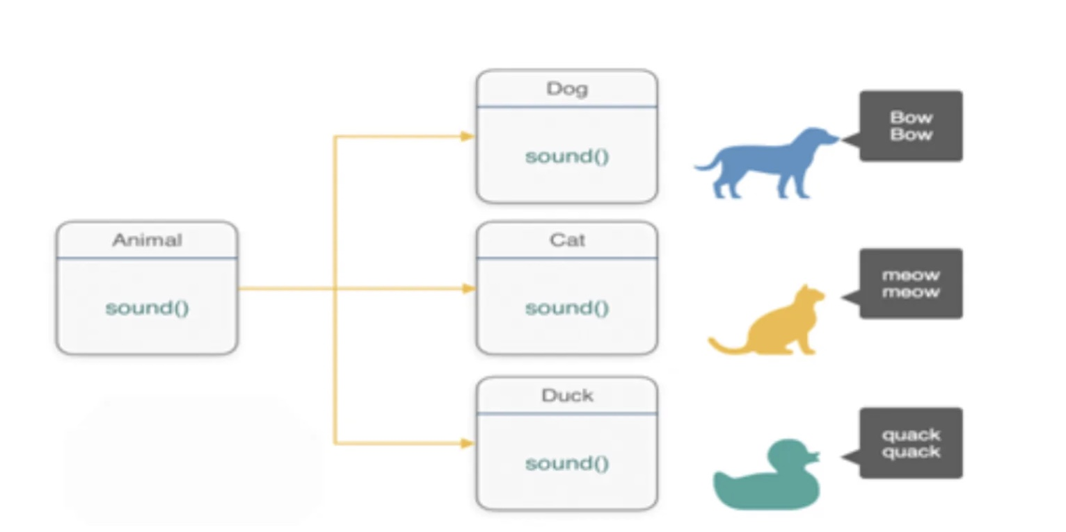
Polymorphism - Example 2

Slide 11
Polymorphism
In OOP, polymorphism allows objects of different classes to be treated as instances of a common superclass or interface. In case of zoo scenario, you can have a superclass called “Animal” that defines a method called “feed.” Each specific animal class, such as “Lion,” “Bird,” and “Elephant,” implements its own version of the “feed” method according to the feeding behavior of that particular animal.
Polymorphism in Programming:
In programming, polymorphism allows a single function or method to operate in different ways based on the input or the object that is calling it.
Notes:
In summary, polymorphism in OOP allows objects of different classes to be treated uniformly as instances of a common superclass or interface. It provides flexibility, code reuse, and simplification in design and implementation. By embracing polymorphism, you can create adaptable and scalable systems in various domains, whether it’s in a zoo, a social media platform, or numerous other real-world scenarios.

Slide 12
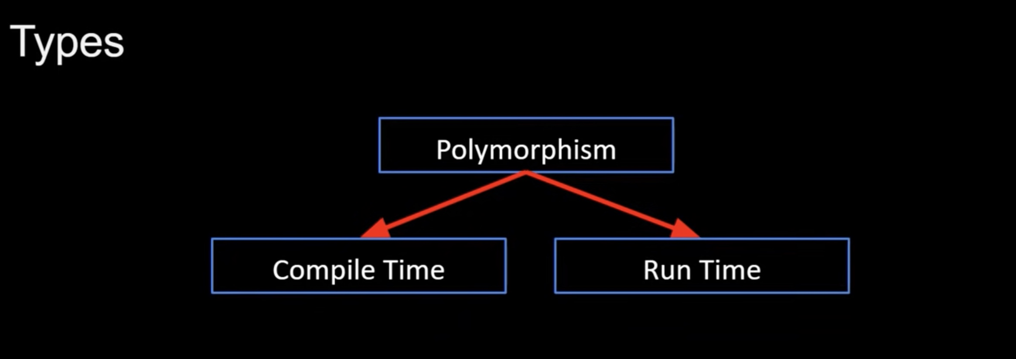
Polymorphism

Slide 13
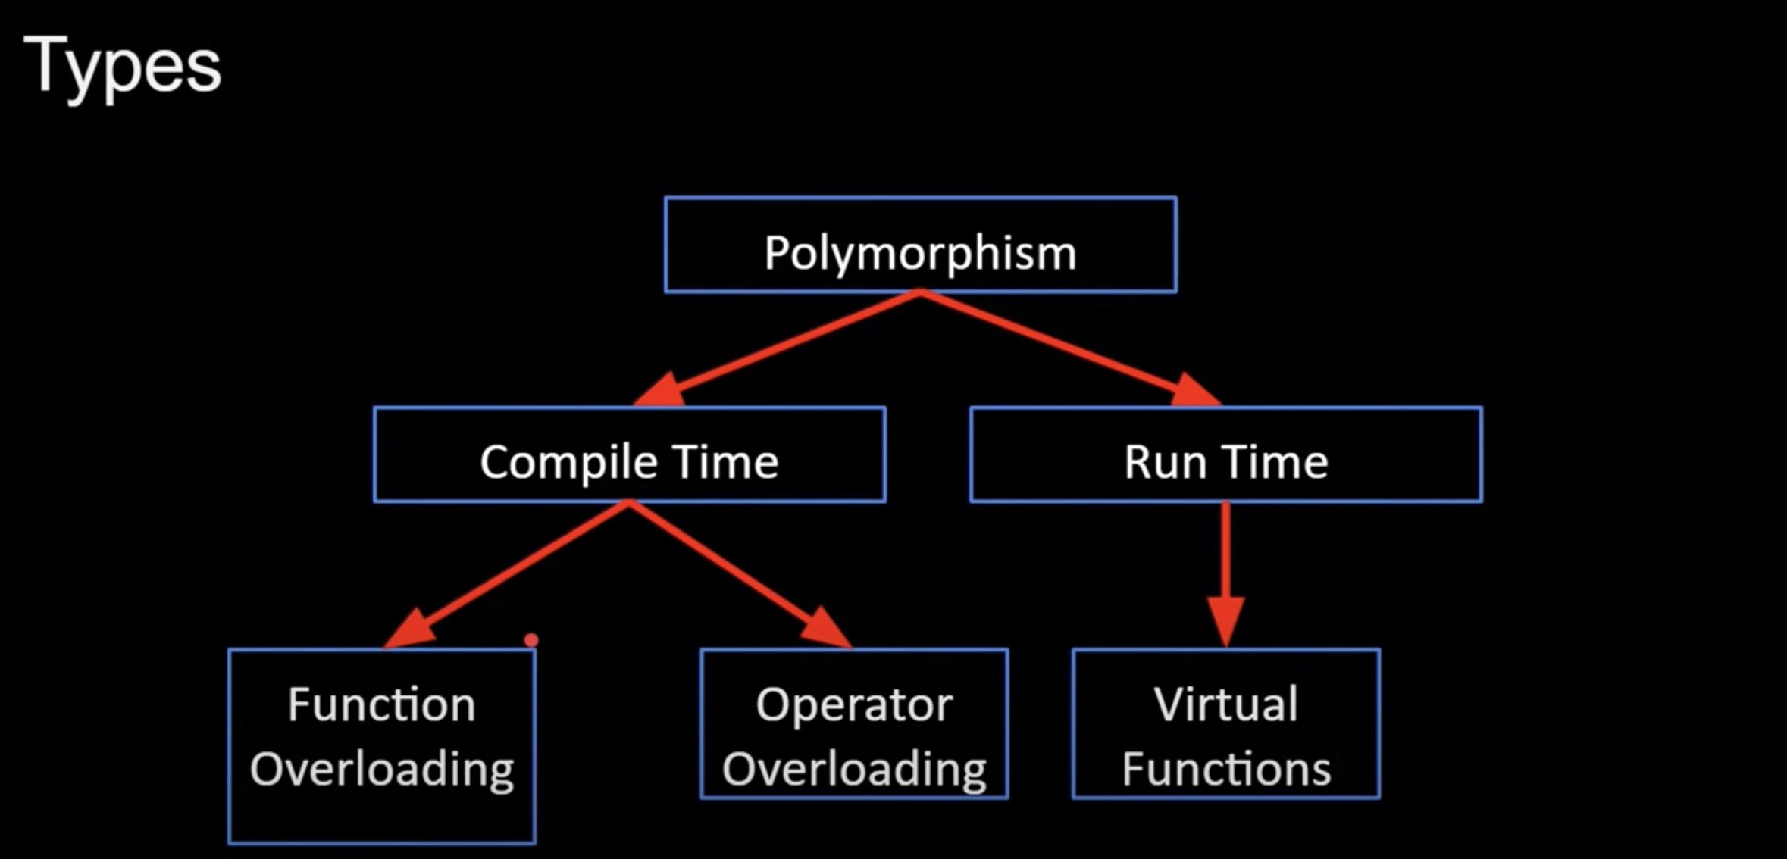
Polymorphism
Notes:
Cellphone example

Slide 14
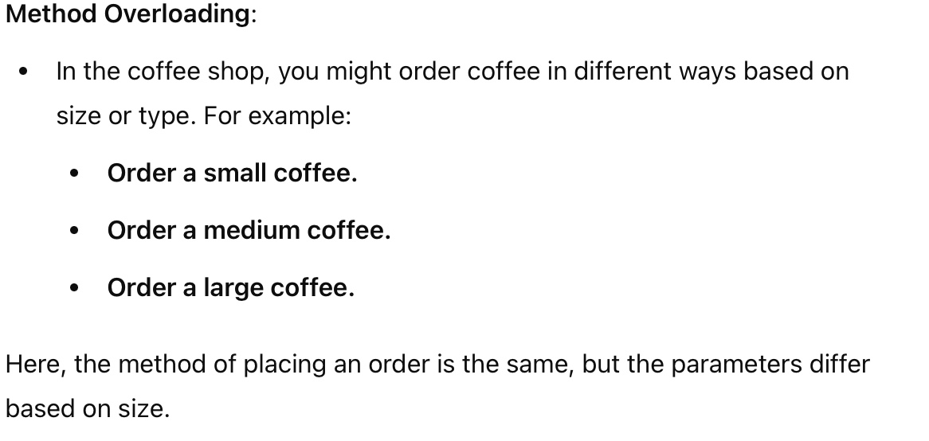
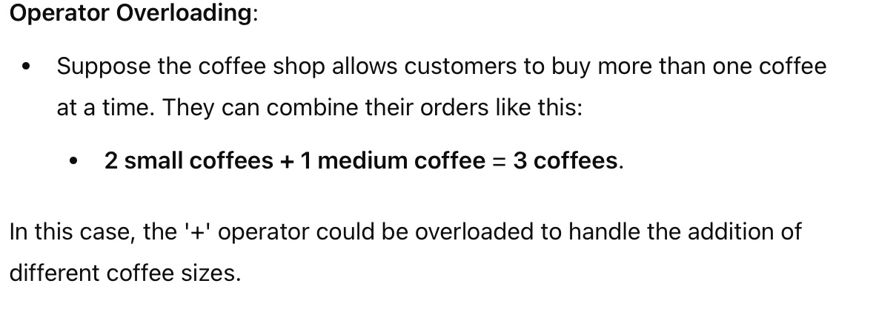
Compile Time Polymorphism (Static Polymorphism)
Function/Method Overloading: Different function with the same name but have different no of arguments or different types of arguments

Slide 15
Run Time Polymorphism (Dynamic Polymorphism)
Function/Method Overriding:
Run-time polymorphism, also known as dynamic polymorphism, occurs when the method to be invoked is determined at runtime. This is typically achieved through method overriding in object-oriented programming, often utilizing inheritance. Let’s explain this concept using the coffee shop example.
Example: Coffee Shop with Different Types of Coffee having specific preparation method. For instance, we might have:
Espresso
Latte
Cappuccino
Notes:
Base Class (Coffee): We have a base class Coffee that defines a virtual method prepare(). This method can be overridden by derived classes.
Derived Classes: Espresso, Latte, and Cappuccino are derived classes that inherit from the base class Coffee. Each of these classes overrides the prepare() method to implement their specific preparation steps.

Slide 16
INFORMATION HIDING
Information is stored within the object
It is hidden from the outside world
It can only be manipulated by the object itself

Slide 17
Class in OOP
A class is an entity that determines how an object will behave and what the object will contain.
In other words, it is a blueprint or a set of instructions to build a specific type of object.
The classes and objects are the most importrant features of C++.
A class is similar to structure but it provides more advanced feature.

Slide 18
Class in OOP (Cont...)
When you define a class, you define a blueprint for a data type.
This doesn’t actually define any data but it does define what the class name means that is what an object of the class will consist of and what operations can be performed on such an object.
A class defination starts with a keyword class followed by the class name and the class body, enclosed by a pair of curley braces.
A class defination must be followed either by a semicolon or a list of declaratrions

Slide 19
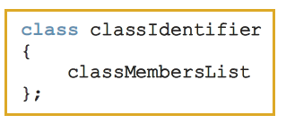
A class is a collection of a fixed number of components. The components of a class are called the members of the class.
Syntax
Variable declarations and/or functions.

Slide 20
Syntax
Class Class_name
{
field;
method;
};
Notes:
Field (also known as an attribute or member variable) refers to a variable that is associated with a class.
Fields store the state of an object. For example, in a Car class, fields could include attributes like color, model, and year.
Fields are usually declared inside the class but outside of any methods. They can have different access modifiers (like public, private, protected) that control their visibility and accessibility.
Methods are functions that belong to a class and define the behavior of the objects created from that class. They can manipulate fields and perform operations related to the object's state.

Slide 21
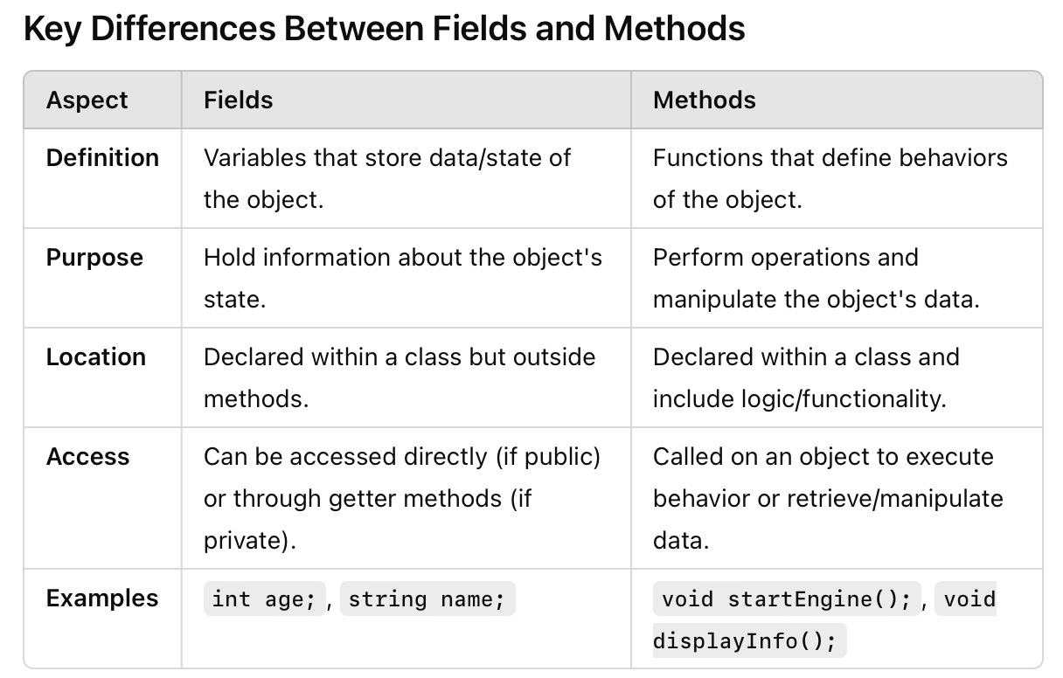

Slide 22
Example:
Class Test
{
private:
int n=10;
public:
void show()
{
cout<<”The value of n:”<<n;
};

Slide 23
Predefined VS. ADTs
Pre-defined Data Types
Abstract Data Types

Slide 24
Predefined VS. ADTs
Predefined data types, also known as primitive data types or built-in data types, are the basic types provided by a programming language as part of its syntax.
Common predefined data types include: Integers (int) , Floating-point numbers(float, double), Characters (char), Booleans (bool), Strings
Characteristics:
Fixed size: The size of predefined data types is usually fixed and depends on the language and architecture.
Direct usage: These types can be used directly in operations without requiring any additional structure.
Limited functionality: Predefined types provide basic operations (like arithmetic for numbers) but do not have methods or properties like complex types.

Slide 25
Predefined VS. ADTs
Abstract data types, are a theoretical concept that defines a data type purely by its behavior (operations) rather than its implementation. They provide a high-level description of the data and the operations that can be performed on it.
Common adts include: stack, queue, list, tree
Characteristics:
Encapsulation: ADTs encapsulate the data and provide a defined interface for interacting with that data.
Implementation independence: The user of an ADT does not need to know how it is implemented; they only need to know how to interact with it.
Operations defined: An ADT defines a set of operations (methods) that can be performed on the data, such as adding, removing, or searching for elements.

Slide 26
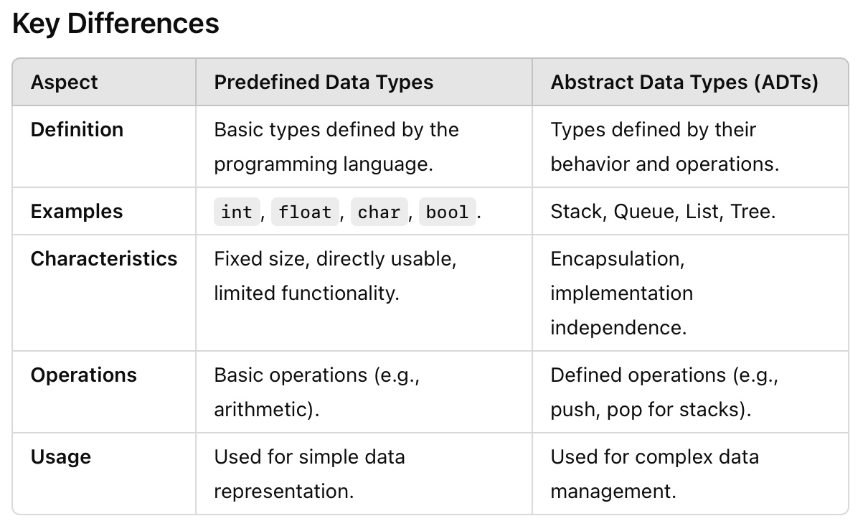
Predefined VS. ADTs

Slide 27
Object in OOP
This is the basic unit of object oriented programming
That is both data and function that operate on data are bundled as a unit called as object

Slide 28
Declaring Object
Class_Name object_Name;
Test T;
Notes:
For example:
We have declared a class Test before and T is its object.

Slide 29
Example: 1
Human being = Class
Man -> is object
Women -> is object

Slide 30
Example: 2
Fruit is a -> Class
Apple -> is object
Mango -> is object
Orange -> is object
Notes:
So if color is a class then what are its objects?

Slide 31
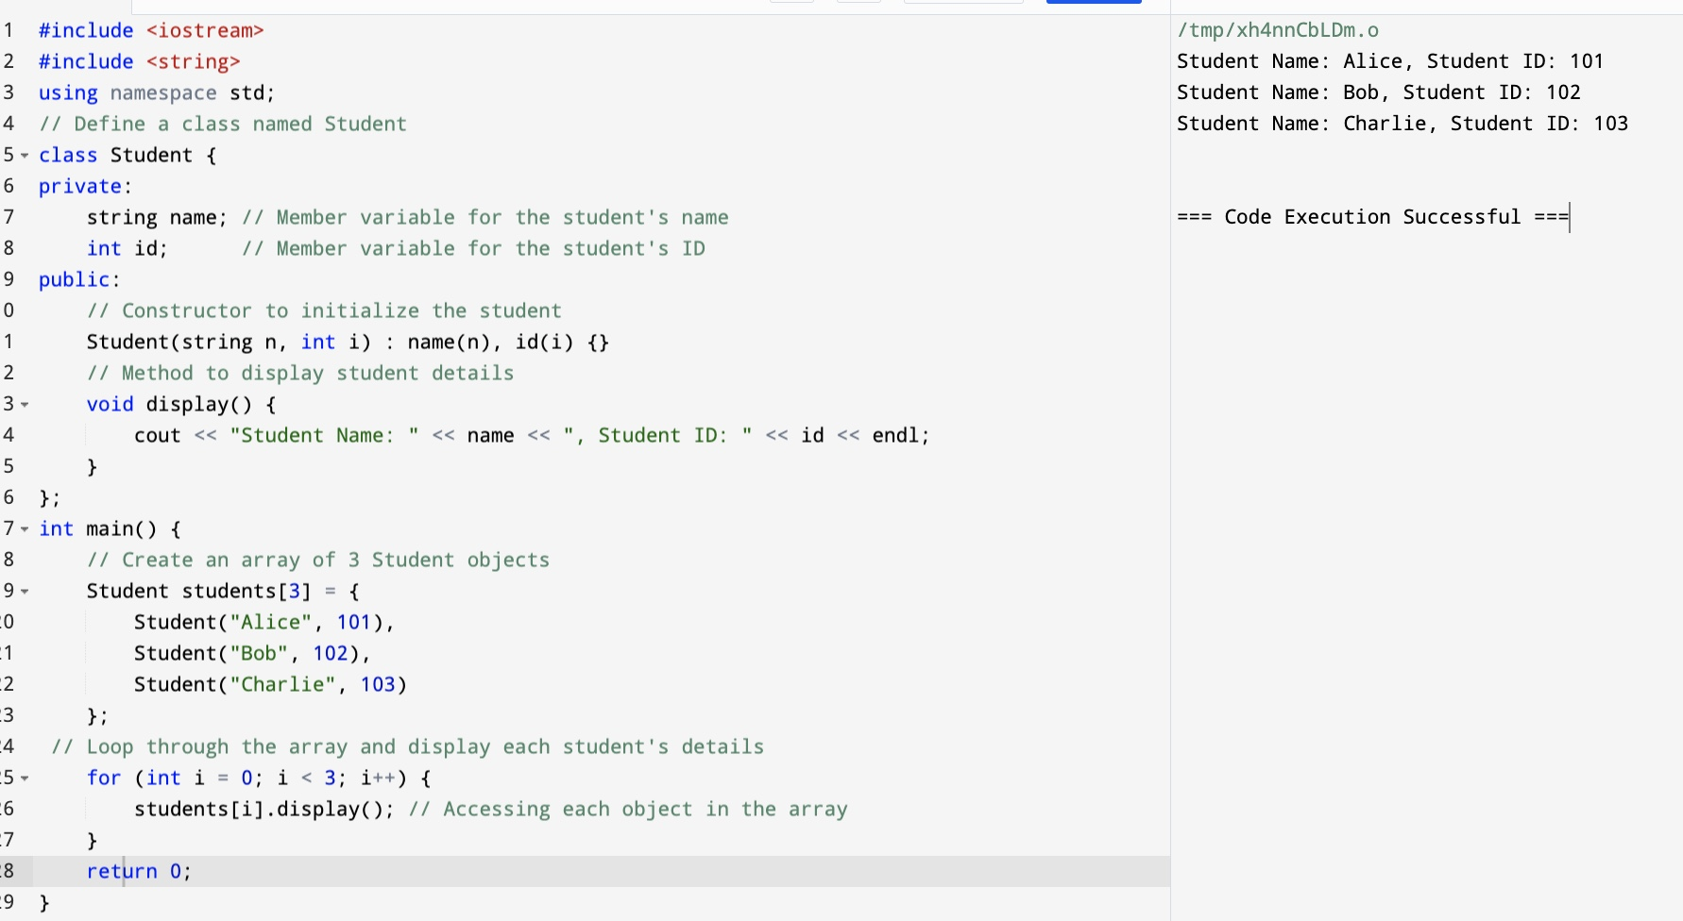
Array of Objects - Example

Slide 32
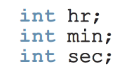
Example class to implement time
Three member variables

Slide 33
Example class to implement time
Operations
Set the time.
Retrieve the time.
Print the time.
Increment the time by one second.
Increment the time by one minute.
Increment the time by one hour.
Compare the two times for equality.

Slide 34
Class
Default Access Specifiers
Class:
If you declare a class without specifying any access specifiers, all members (variables and methods) are private by default.
Notes:
class MyClass {
int x; // private by default
};

Slide 35
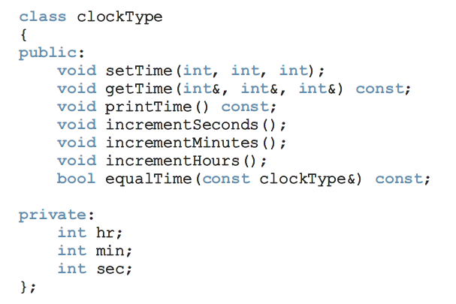
Note the semi-colon.

Slide 36
Member variables. Cannot be initialized here.
Notes:
The private access specifier is essential for implementing encapsulation. It hides the internal details of the class and only allows controlled access through public methods. This makes your class more secure, robust, and easier to maintain.
The const before clockType& means that the object passed as a parameter cannot be modified by the function. The function will only "read" the data from the object, not change it.
const at the end of the function:
This means that the function will not modify any of the member variables of the current object (the object on which the function is called).

Slide 37
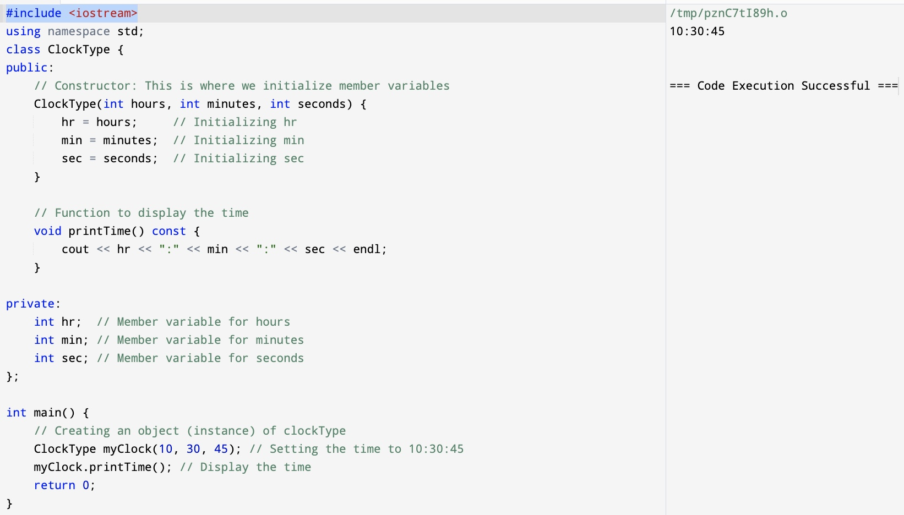
How can we initilize?
Notes:
Check Task 3.cpp for this

Slide 38
Member functions, declared as function prototypes.
Notes:
bool equalTime(const clockType& other) const {
return (hours == other.hours) && (minutes == other.minutes) && (seconds == other.seconds); }
Explain function prototype with chocolate cake example: class : recepie book, member function -> different recepies, Function prototype -> ecepie title

Slide 39
Member functions can access member variables directly. No need to pass them as parameters.

Slide 40
End of Lecture

